Slide 1
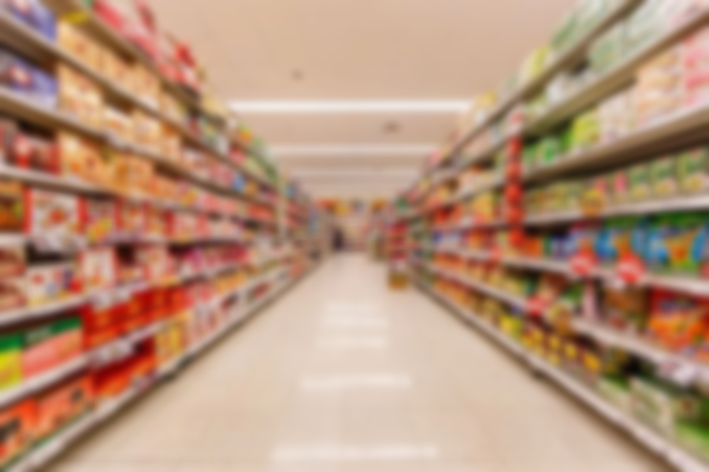
Capstone Project
Marketing and Retail Analytics
Presented By: Mayur Padore | Priya | Nisha R

Slide 2
AGENDA
INTRODUCTION
OBJECTIVE
DATA PREPARATION
KEY FINDINGS
INSIGHTS
RECOMMENDATIONS
APPENDIX
DATA SOURCE
DATA METHODOLOGY
DATA ASSUMPTIONS
CONCLUSION

Slide 3
INTRODUCTION
E-commerce companies operate in the online marketplace and facilitate the buying and selling of goods and services over the internet.
OList is one such e-commerce company that has faced some losses recently and they want to manage their inventory very well so as to reduce any unnecessary costs.

Slide 4
OBJECTIVE
Identify the top products contributes to revenue and the leading products category using Pareto Analysis.
Improve our understanding of customer purchase behavior through market basket analysis.
Determine which items are most likely to be purchased individually or in combination with other products.
Need to help OList to identify the product categories.

Slide 5
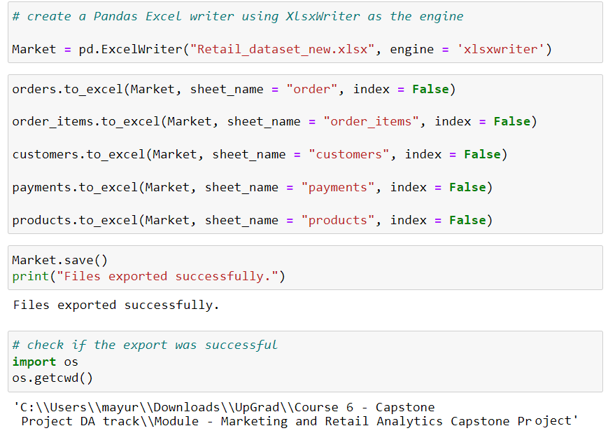
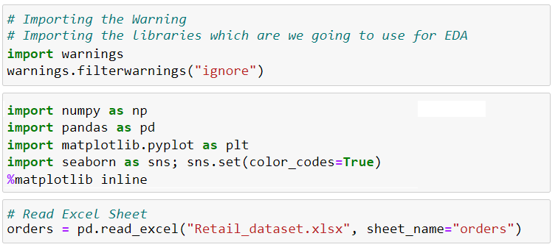
DATA PREPARATION
For the data preparation, we use Jupyter Python notebook.
Import the warnings and the required libraries which we used for data.
Read the excel file.
Transform this file and a make clean version of the retail dataset.
Perform EDA, missing values and treat them with substitute.
For this capstone, consider only the cases having order status as 'delivered'.

Slide 6
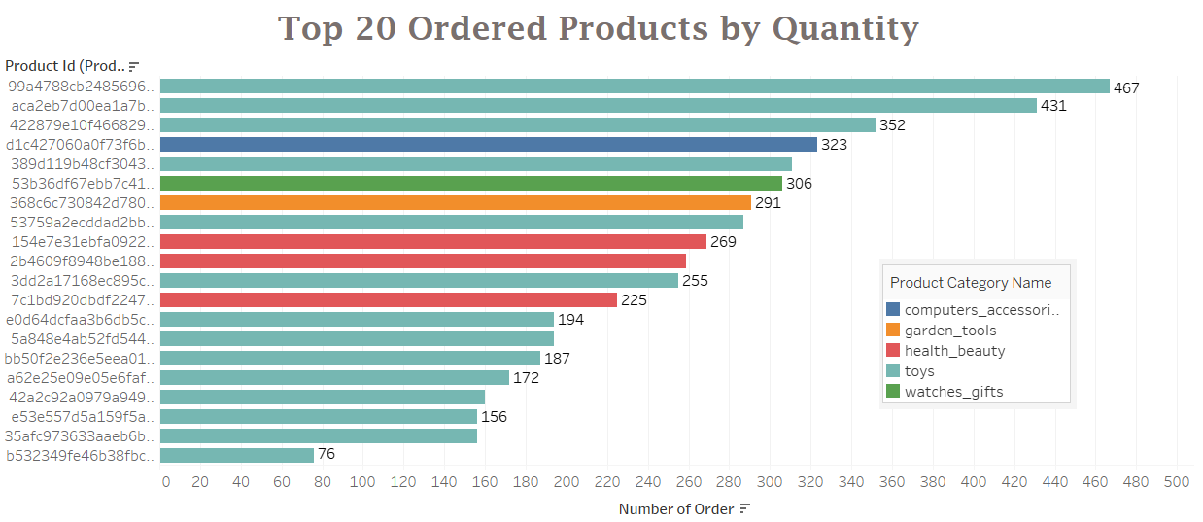
Top 20 Ordered Products by Quantity
The highest ordered products, with 467 orders, belongs to the “Toys” category.
The majority of frequently ordered products in the top 20 also belong to the Toys category.

Slide 7
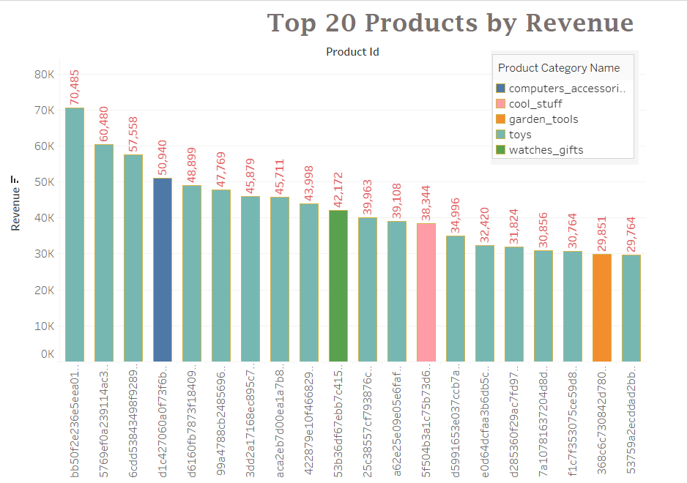
Top 20 Ordered Products by Revenue
The highest revenue, 70,485, is generated by a products in the Toys category & computer accessories with 50,940.
Most products in the top 20 generating high revenue are also from the Toys category.

Slide 8
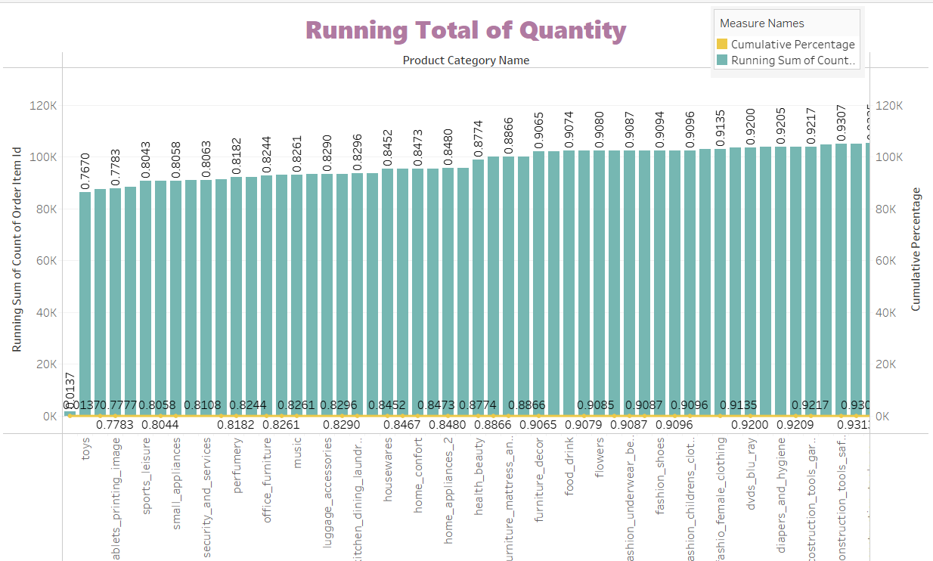
Percent Running Totals
The Percentage of Total Running and Quantity Ordered has been broken down by Products ID.
This allows us to identify the contributions of each product to the total revenue.

Slide 9
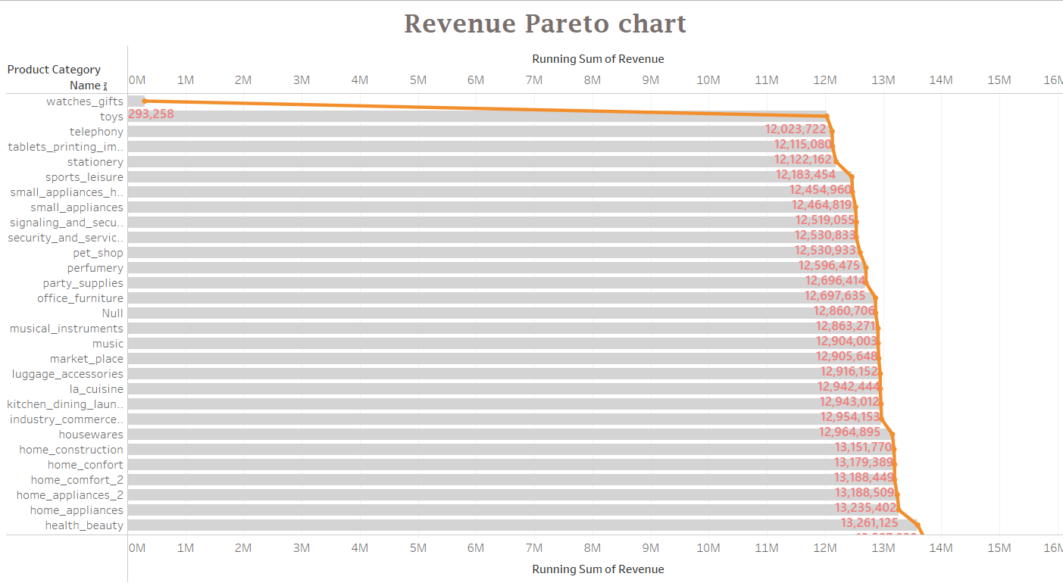
Revenue Pareto
Toys, health_beauty, and watches_gift together generate 80.56 % of the revenue.
Toys alone account for 76.23 % of the revenue.
Remaining 70+ products categories generate 19.44 % of the revenue.

Slide 10
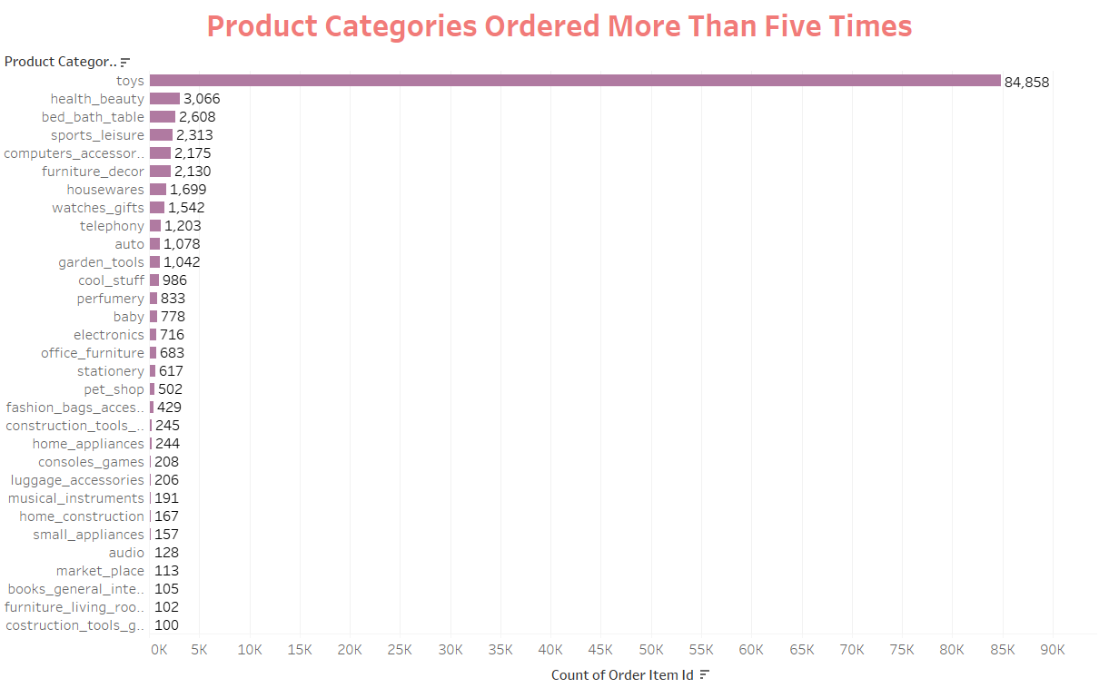
Product Category Ordered> 5 Times
Toys are the most ordered category with 84,585 orders.
Following Toys, health_beauty, bed_bath_table, and sports_leisure are the next most ordered categories.

Slide 11
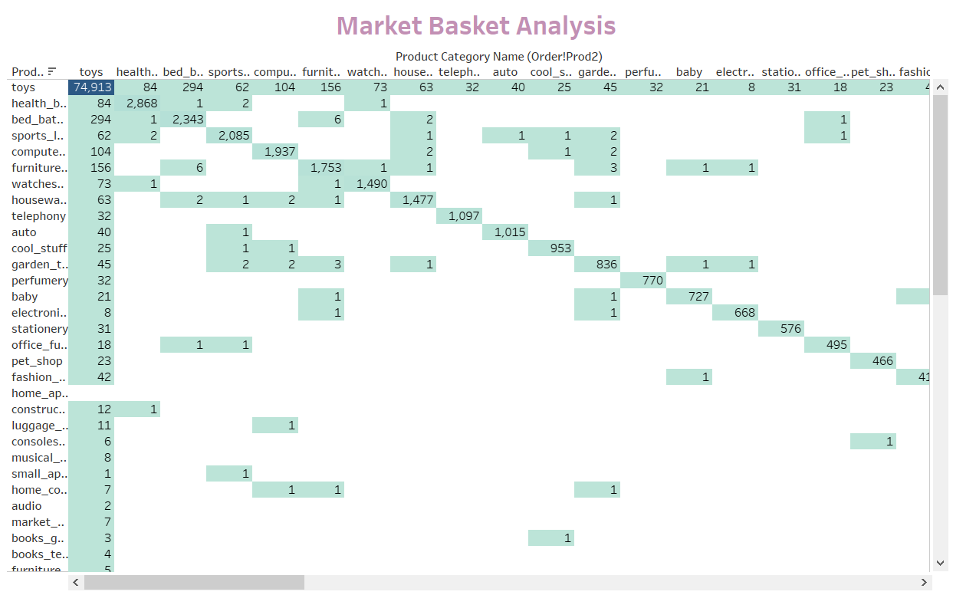
Market Basket Analysis
Market Basket Analysis identifies frequently ordered category associations.
Toys are most often ordered along with bed_bath_table, furniture_decor, computers_accessories and health_beauty.

Slide 12
INSIGHTS
The Category “Toys” is the highest selling product in terms of sales and revenue.
“Toys” Category, contribute only 20% of the products, which generate 80% of the revenue.
18.4% of the customers are recurring, whereas 40% of the customers are either lost or on the verge of leaving. Thus we need to look at the core issues, what is leading to this loss.
Besides Toys products from bed_bath_table, furniture_decor, computers_accessories, and health_beauty are frequently ordered.
These categories either individually or in combinations with Toys, appear most frequently in customer’s baskets.
It is observed that despite of the high prices, some products are frequently purchased by the customers.

Slide 13
RECOMMENDATIONS
Based on our findings:
The company should focus on maintaining inventory for categories generating over 80% of the revenue.
Company should maintain toys, computes accessories, furniture and sports related accessories in their inventory.
Target customers who are more likely to purchase toys to boost sales, as it is the most ordered category.
Offer promotional codes or discounts on frequently ordered category associations to encourage cross-selling.
Consider reducing sub-categories with very low sales to optimize inventory management.

Slide 14
Appendix - DATA SOURCES
Hers’s an overview of our dictionary, which includes key information categories:
Order Details: This category encompasses data elements like order ID, order status, order purchase, timestamp and more.
Order Items Details: Within this category, you’ll find information such as order item ID, seller ID, item price, shipping charges and related details.
Customer Details: This section includes data related to customers, including customers ID, customer city, customer state, and other pertinent information.
Payment Details: Here you’ll find data pertaining to a payment transactions, including payments type, payment value and other relevant payment related details.
Product Details: This category covers product-specific data, such as product ID, product category name, product dimension and related information.
We sourced our data from the OList retail dataset which provides comprehensive information related to orders. This dataset covers the period from 2016 to 2018, allowing us to conduct a thorough analysis of historical data and draw meaningful insights.

Slide 15
Appendix - DATA METHODOLOGY
Our Data analysis process included:
Cleaning and Transforming the dataset using Python libraries (Pandas and NumPY) in Jupyter Notebook.
Replacing missing values with suitable alternatives.
Removing redundant and duplicate record, retaining only the first occurrence.
Creating a new dataset for Market Basket Analysis, focusing on order ID and product category name.
Performing various visualizations and Market Basket Analysis in Tableau.

Slide 16
DATA ASSUMPTIONS
To maintain focus and relevance, we made the following assumptions:
Consider only cases with “Delivered” order status.
Assumed that the provided data achieved the Desire revenue.
Assumed the company has no plans to expand to new warehouses.
Formulated recommendations under the assumptions of confused sales growth.

Slide 17
CONCLUSION
In Conclusion, our analysis of OList marketing and retail analytics has provided valuable insights into product performance, customer behavior and revenue generation. By implementing our recommendations, OList can optimize its inventory, boost sale, and improve of profitability insuring a more sustainability future for the company.

Slide 18
THANK YOU

